Slide 1
TEAM STORY
Motivation
Mission: To empower everyone’s project viewing experience.
Meet the team members and appreciate the team diversity.
Understand the origin of the project and team.
Be energized by the passion and commitment.

Slide 2
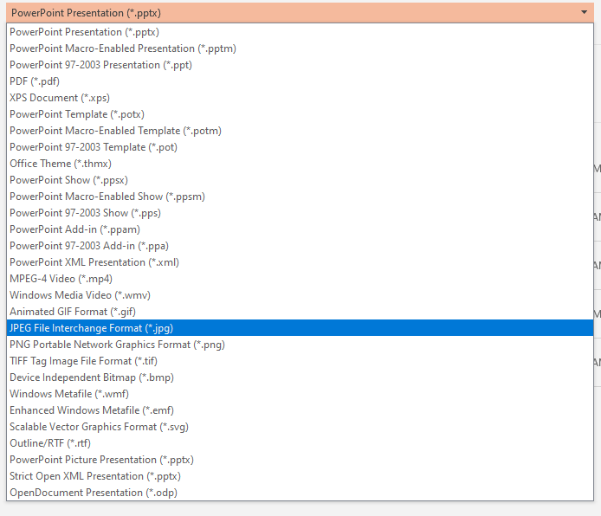
Instructions for creating a Team Story
Use slides 3, 4, and 5 as a guide
Add your team story to each of the slides
Save each slide as an image file
File > Save As > JPEG File Interchange Format (*.jpg)
Each slide will be saved as an individual picture (Save to desktop to access quickly and it might save all pictures in one folder)
Go to your project page, edit your project
In the Team Story tab, upload your 3 pictures
Save project!

Slide 3
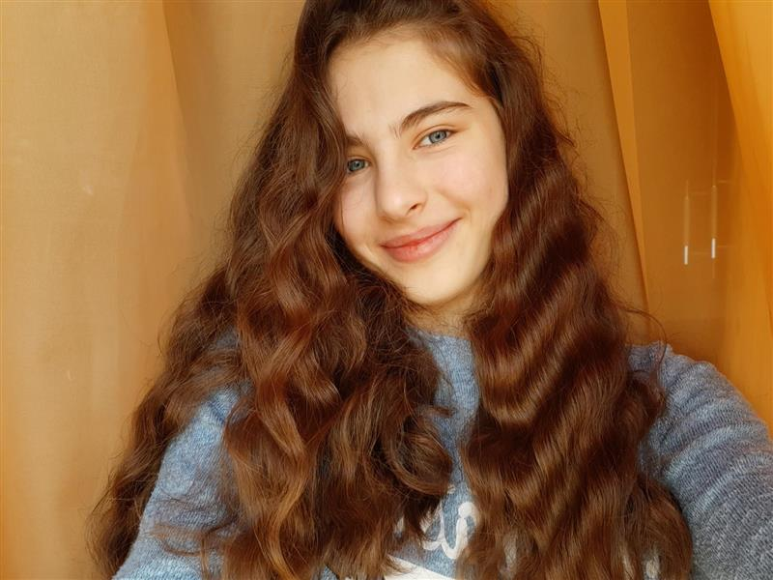
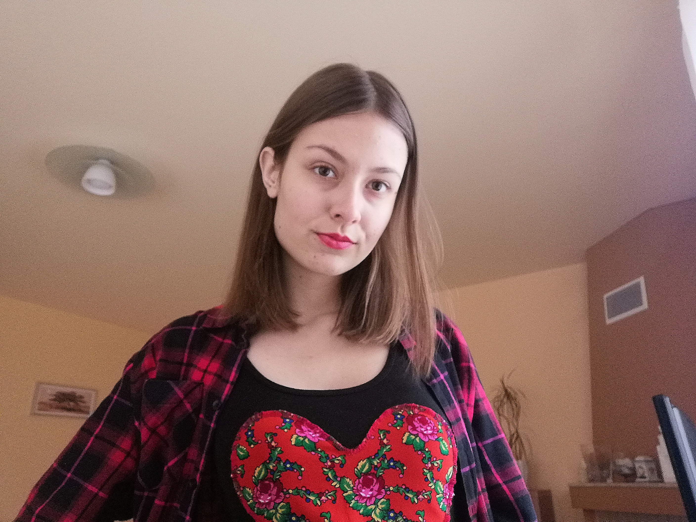

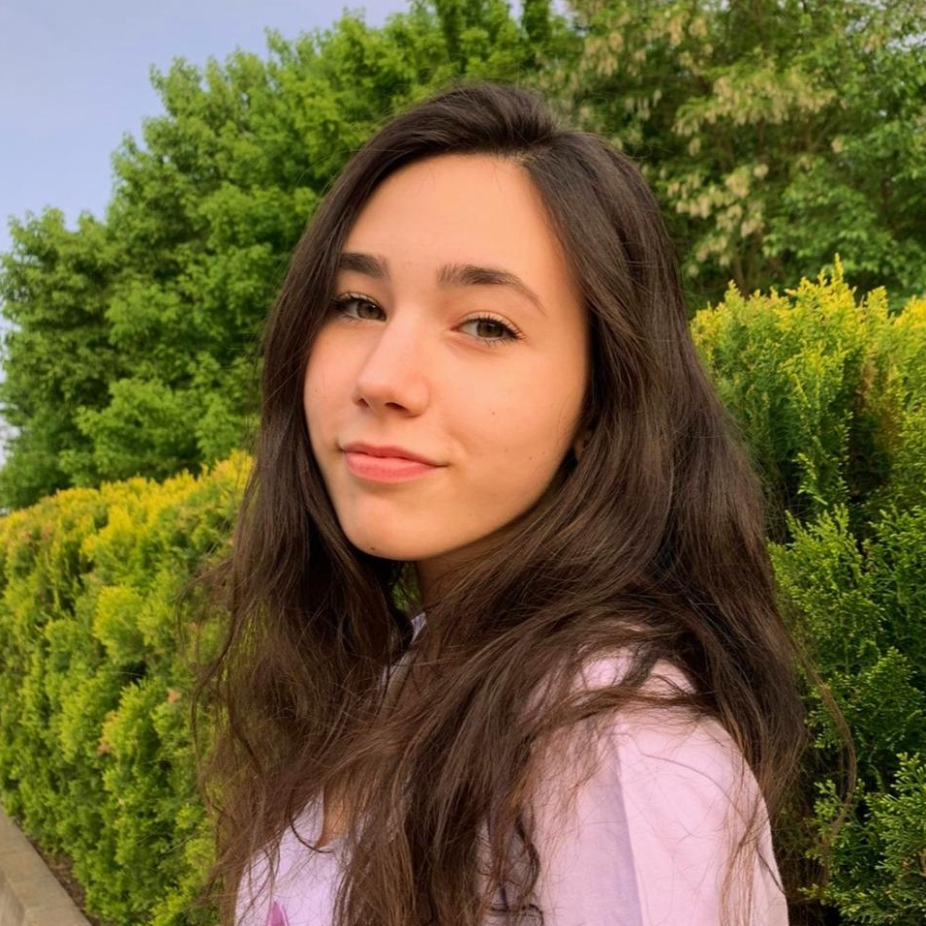
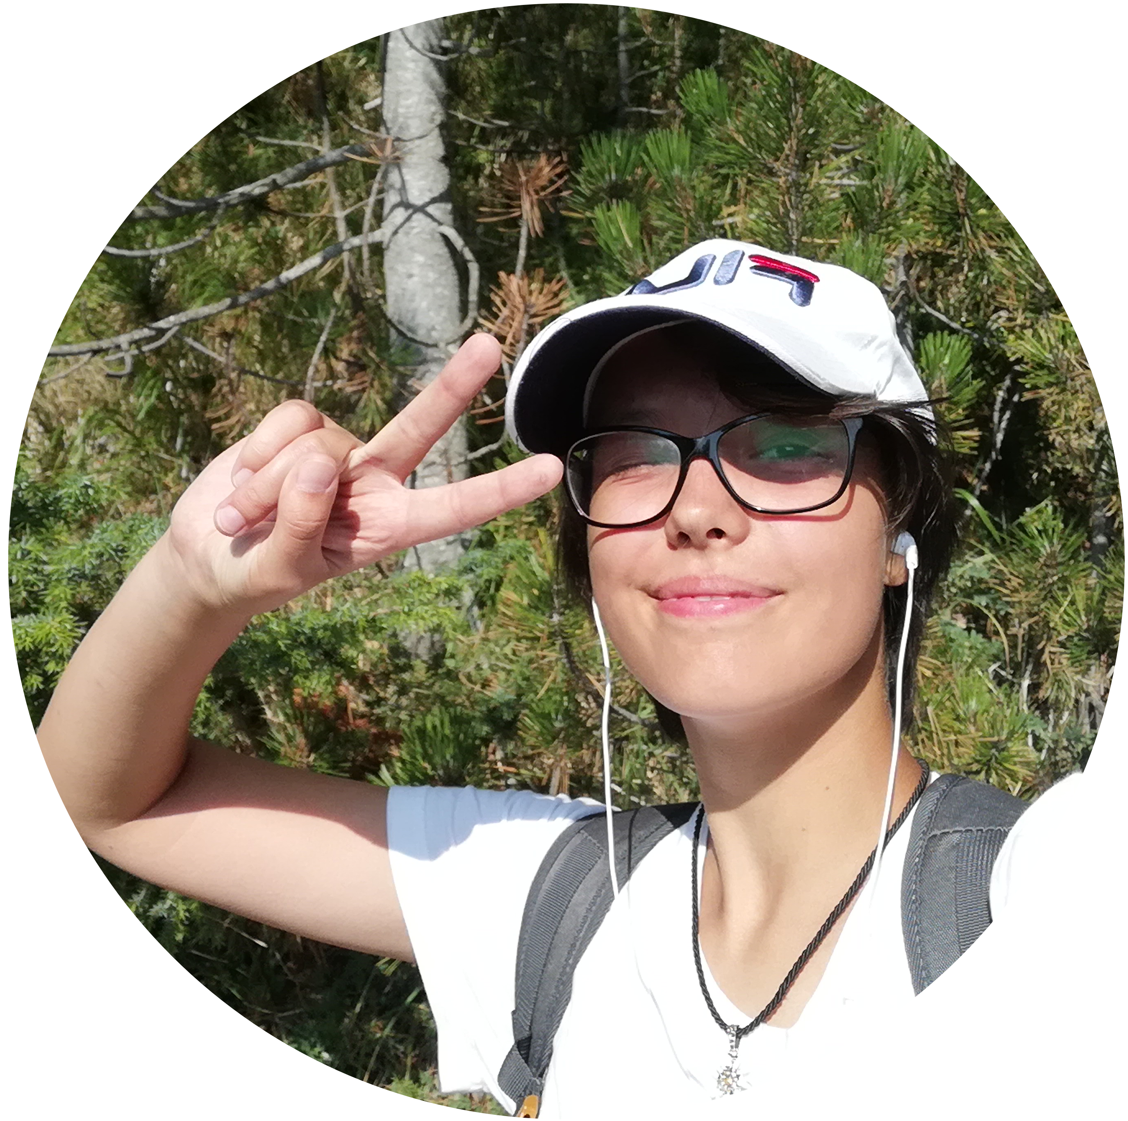
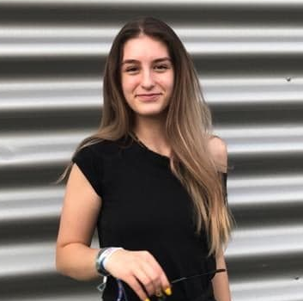
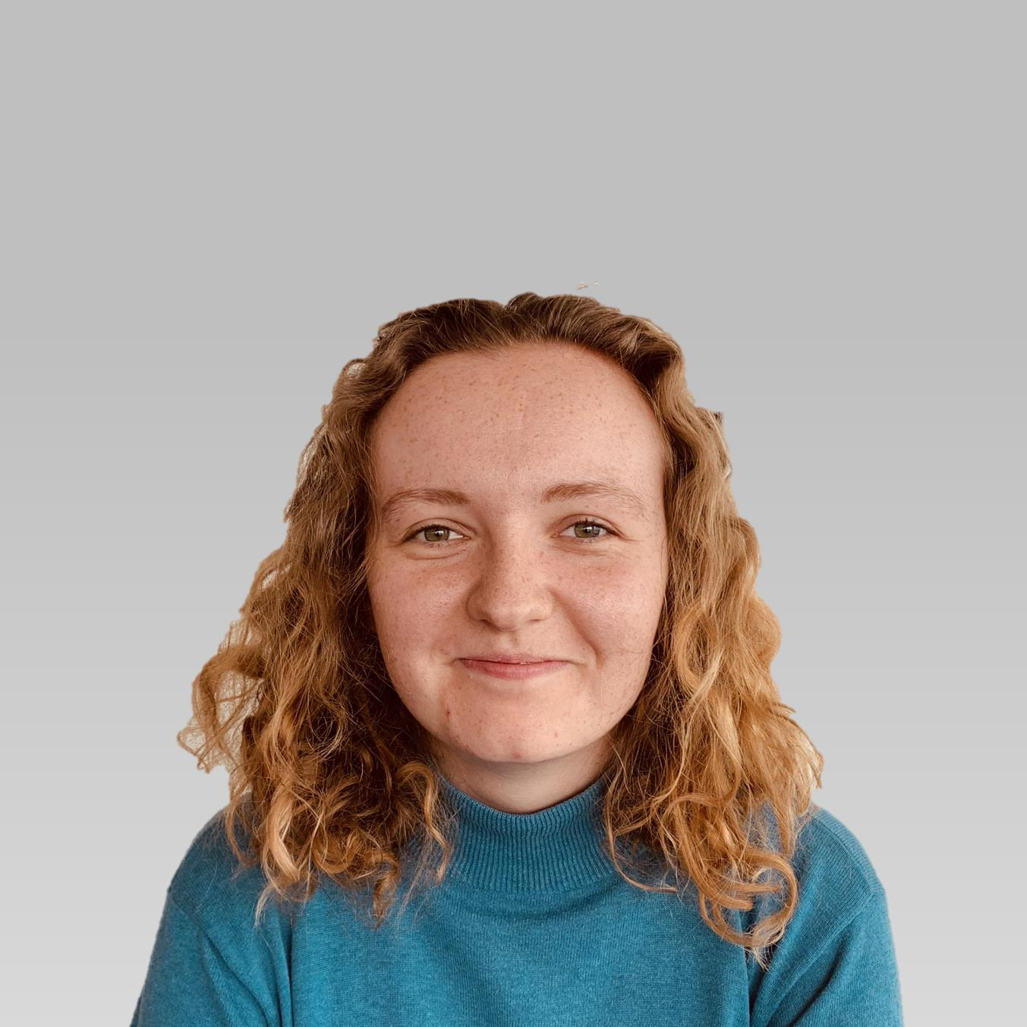
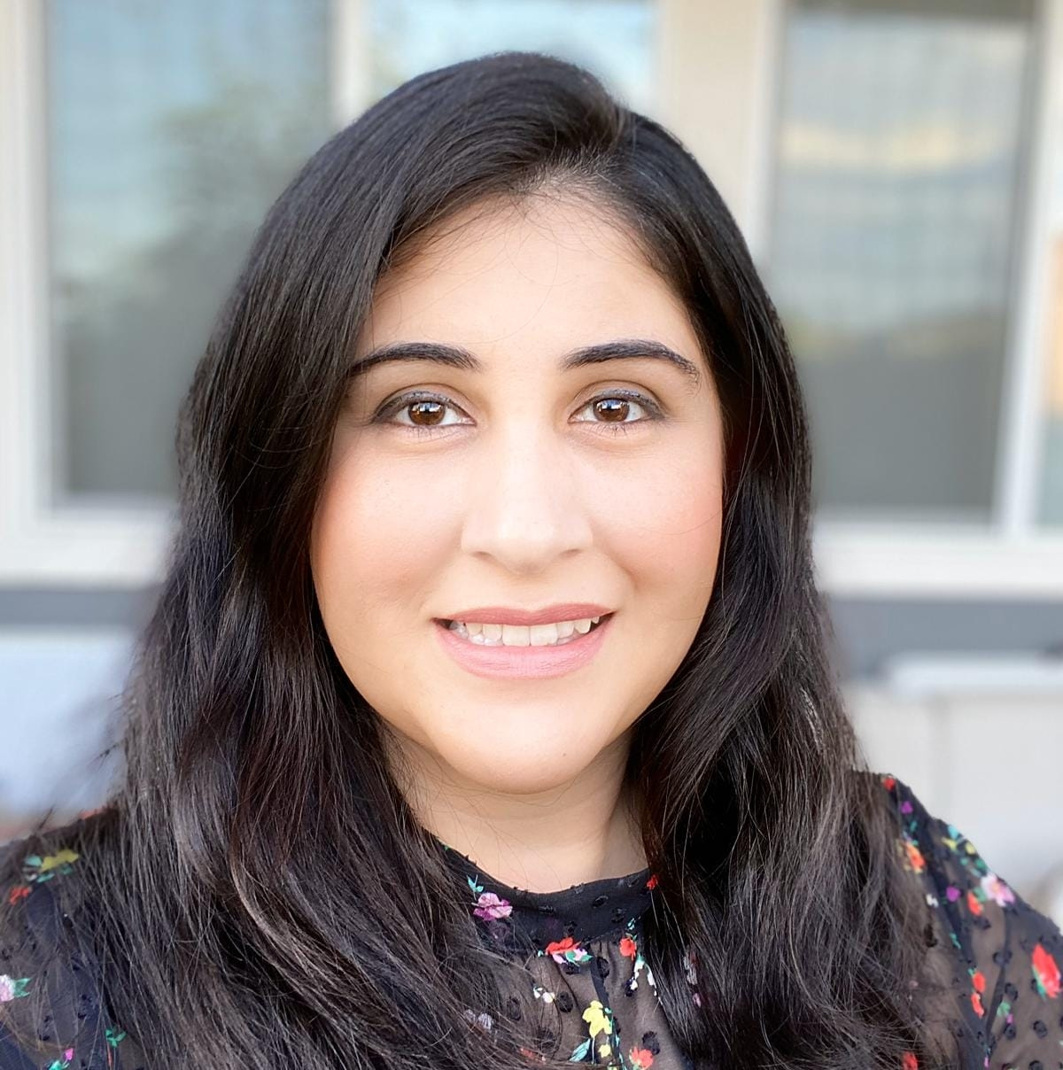
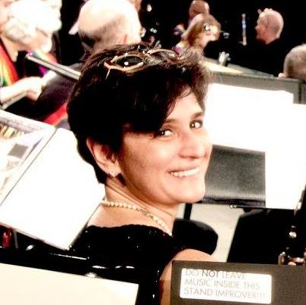
Turing Tested
Sara Barbu
Student, Athlete
Focșani, Romania
Maria Szymańska
Student
III LO im. Cypriana Kamila Norwida
Konin, Poland
Tudosa Mara
Student, Volunteer, Member of the school council
Suceava, Romania
Anca Strulea
Student, Volunteer, Robotics enthusiast
Deva, Romania
Stefania Ghita
Student, Actress in the free time
Bucuresti, Romania
Muazma Zahid
Sr. Engineering Manager Microsoft Azure Global
Redmond WA
Pamela Krzypkowska
Partner Technology Strategist
Warsaw, Poland
Ana Del Campo Mendizabal
Sr. Cloud Solution Architect Microsoft
New York

Slide 4

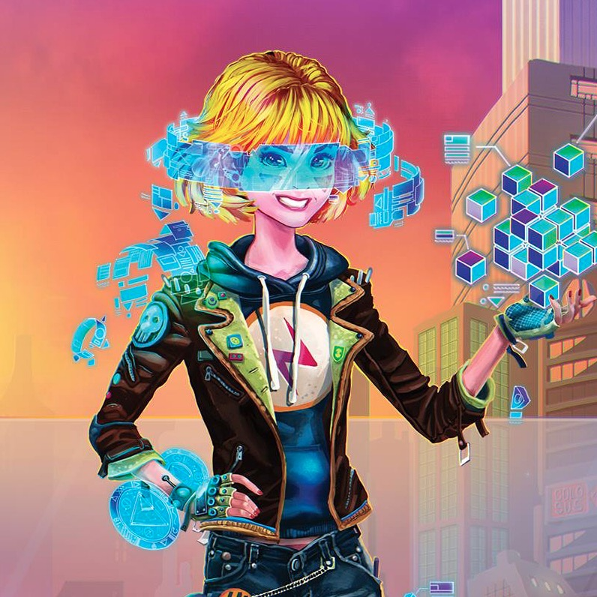





How did we came to be?
We believe in working together to solve problems
What brought us together is being open minded about various subjects
We want to stop the abuse towards children and bullying in any shape or form
We are all here thanks to Alice!
Great experience from Alice Envisions the Future made us want to try again and do something good for people in need
We wanted to try again and have fun along the way
We are the team of open minded people that want to change the world for the better
Creativity is a key to fun
We believe that technology can help us solve many important problems
We are stronger together!

Slide 5
Let’s Talk Passion
Our own hard experience and the lack of interest from others made us want to solve this problem
Our team’s average age is just 19 years so we know how hard it is to look for help
Microsoft Hackathon enables us to put our ideas into reality
We want you to remember (in general and forever!) that you should never be afraid to ask for help!

